Slide 1
Model-based decomposition
SEATS

Slide 2





Unobserved components model (AMB)
Theoretical models
Series($θ_{Y})$
Trend($θ_{Y})$
Seasonal($θ_{Y})$
Irregular($θ_{Y})$
=
+
+
Independent
$${\hat{θ}}_{Y}$$
Observed time series

Slide 3





Unobserved components model (STS)
Theoretical models
Series($θ_{T,S,I})$
Trend($θ_{T})$
Seasonal($θ_{S})$
Irregular($θ_{I})$
=
+
+
Independent
$${\hat{θ}}_{T,S,I}$$
Observed time series

Slide 4
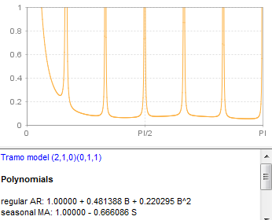
(Pseudo-)spectrum ≡ another way of representing an ARIMA model
Low-frequencies (trend)
Seasonal-frequencies
TD frequency

Slide 5
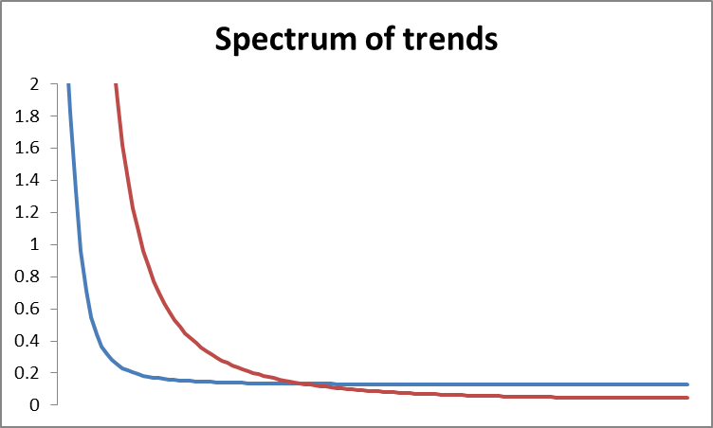
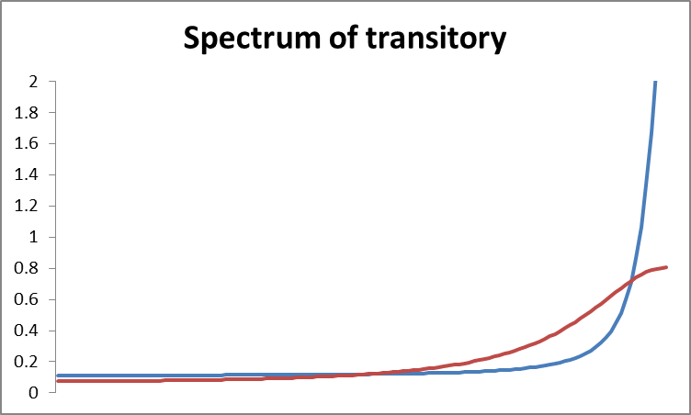
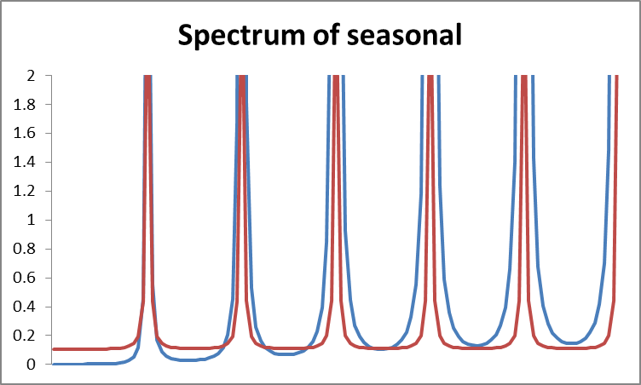
Smoother trend
Switchback pattern
More stable seasonal

Slide 6
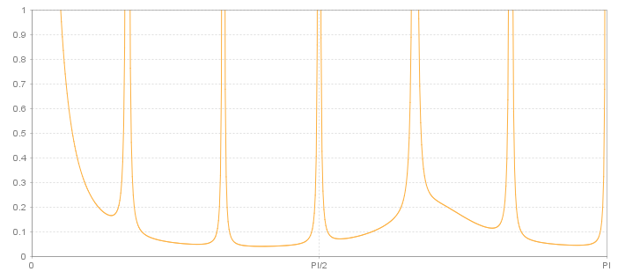
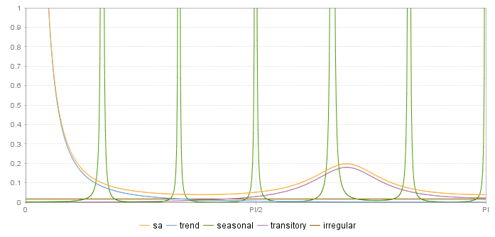


Unobserved components model. Spectral analysis
$$S_{Y}=S_{T}+S_{S}+S_{Tr}+S_{I}$$
$$S_{SA}=S_{T}+S_{Tr}+S_{I}=S_{Y}−S_{S}$$
Independent components !

Slide 7
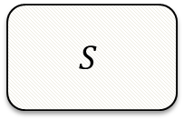
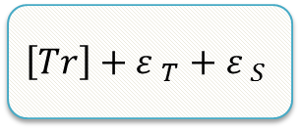
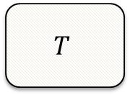
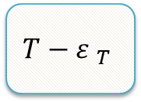
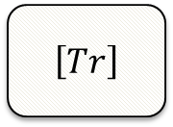
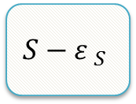
SEATS decomposition
Factorization based on the auto-regressive part (AR and I)
ARIMA
$$T$$
$$S$$
$\left[Tr\right]$
See:
Gomez and Maravall…
Canonical decomposition
$$T−{ε }_{T}$$
$$S−{ε }_{S}$$
$$\left[Tr\right]+{ε }_{T}+{ε }_{S}$$

Slide 8
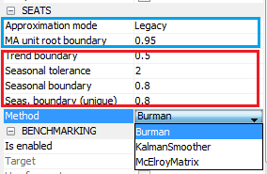
SEATS in JD+
Modification of the model
Decomposition of the model
Estimation of the components

Slide 9
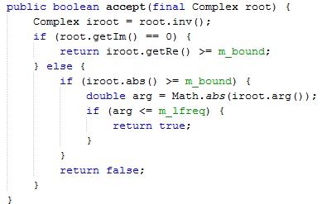
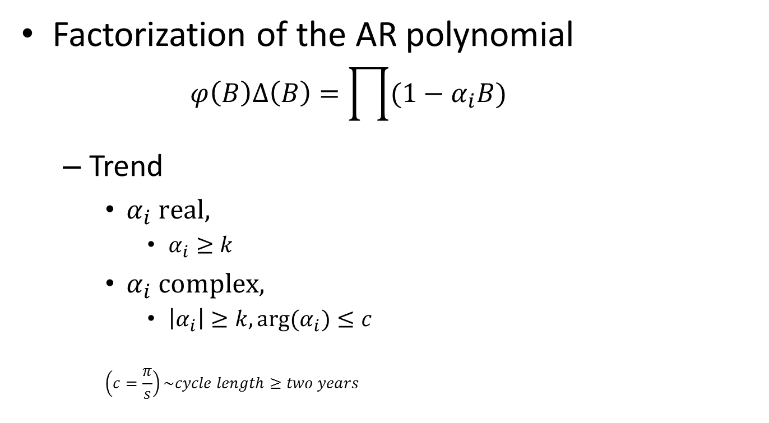
SEATS decomposition (I)
Factorization of the AR polynomial
$$φ\left(B\right)Δ\left(B\right)=\prod{(1−α_{i}B)}$$
Trend
$α_{i} real,$
$α_{i}≥k$
$α_{i} complex,$
$\left|α_{i}\right|≥k, arg(α_{i})≤c$
$$\left(c=\frac{π}{s}\right)\sim cycle length≥two years$$
TrendCycleSelector.java

Slide 10
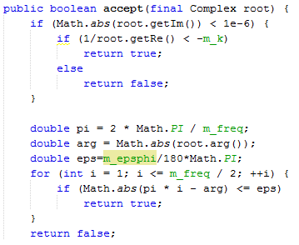

Seasonal
$α_{i} real,$
$α_{i}<−l$
$α_{i} complex,$
$\left|arg\left(α_{i}\right)−f_{s}\right|≤e$
$$f_{s} seasonal frequency$$
Transitory (I)
All other roots
SeasonalSelector.java
Trend boundary | k
Seasonal tolerance (degree) | e
Seasonal boundary | l
Seas.boundary (unique) | l (no seasonal part)

Slide 11
Seats decomposition (II)
Impact of the parameters
k
Small: possible « noisy » trend
k ≈ 1: more stable trend
e
Large (>5): possible short term cycle in the seasonal (for instance, stochastic TD)→erratic seasonal
l
Small (<.8): higher risk of erratic seasonal
General consideration: threshold effects are unavoidable (only in case of AR polynomials)

Slide 12
Non decomposable models
Some models are not decomposable (often due to complex (MA) models)
Best solution: change yourself the model in Tramo
Otherwise:
Legacy: Seats search for another SARIMA model
Noisy: Seats add noise in the initial model (→ I = Tr[= 0])

Slide 13
Estimation of the components
3 solutions, strictly equivalent (except for SD)
Burman algorithm (WK filters): legacy solution, fastest
Kalman smoother: more stable, exact SD
[Matrix computation]
Exception:
Burman and Matrix computations are unstable if quasi-unit roots in MA →Fix MA unit roots boundary
No such problem with the Kalman smoother
Unit roots in MA →fixed seasonal or linear trend (?)

Slide 14
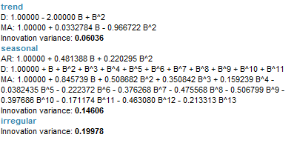
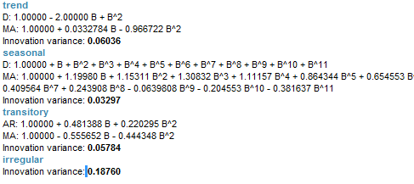
Example
II. Epsphi=2
I. Epsphi=.01

Slide 15
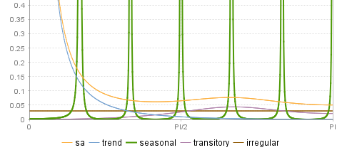
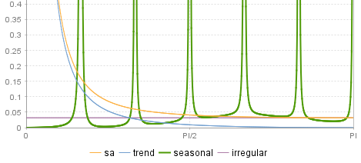
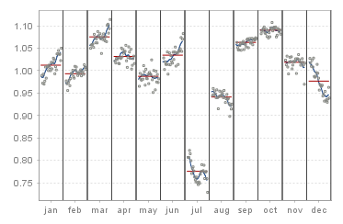
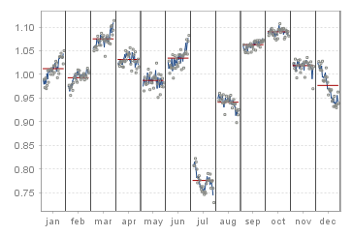
Epsphi=.01 | Epsphi=2

Slide 16
SEATS specific diagnostics
What matters?
SA/S “smoothness”
Size of seasonal innovation (SD < 0.75)
Significant seasonality
Model-based diagnostics
Variance estimators<> variance estimates
Auto-correlations of SA, I !!
Revision analysis
Problems if
Fixed model/parameters
Very “bad” series

Slide 17
To go further
See:
“SEASONAL ADJUSTMENT AND SIGNAL EXTRACTION IN ECONOMIC TIME SERIES”,
by R. Gomez and A. Maravall

